Slide 2
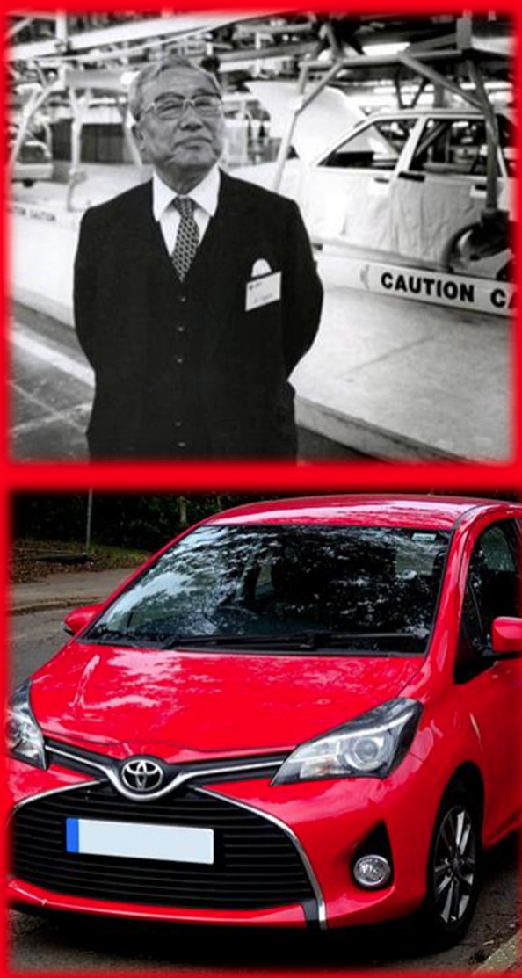
CASE BACKGROUND
Company: Toyota Motor Corporation
President: Akio Toyoda
Founder: Kiichiro Toyoda
Year Founded: 1937
Headquarter: Aichi, Japan
Type: Public
Products & Services:
Automobile | Materials Handling Equipment |Textile Machinery Financial Services | Biotechnology and Afforestation Boats and Marine Engines | Housing Services
Competitors:
Nissan | Ford | Volkswagen | Hyundai | Honda | General Motors | Tesla Mazda Motor | Chrysler | Mercedes Benz | BMW | Porsche

Slide 3
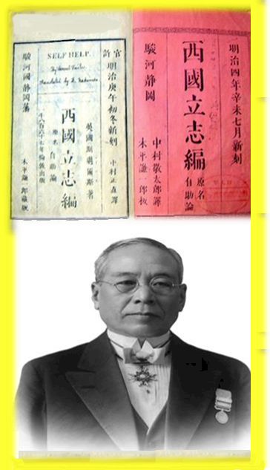
TOYOTA SUCCESS STORY
The story behind the success of Toyota is very important in how Toyota became the company that it is today.
In Japanese culture, the number eight is believed to bring in luck and prosperity
In 1936, Toyoda was renamed to Toyota because Toyota required only eight brush strokes to write in Japanese
The reasoning behind his son’s idea for the name change was due to the meaning of Toyoda in Japanese which means, 'fertile rice paddies'.
Sakichi Toyoda founded Toyota Industries on November 1, 1926, in Japan.
His inspiration for finding Toyota came from observing the struggles of his mother, and from a self-help book called, 'SaigokuRisshi yen' published in 1870 which was originally a translated version of Samuel Smiles, 'English self-help'

Slide 4
Opportunities
Toyota’s main opportunities in the automotive industry involve technological innovation, diversification, growth, and expansion.
Technological innovation: The company can further increase research and development investments.
Toyota vehicles are the most innovative, which is an advantage over the other companies.
By increasing research and development costs, it boosts competitive advantages in support of Toyota’s generic strategy for competitive advantage and growth.
Sustainability: Toyota can develop new engines and designs to improve the fuel economy of its products, especially trucks.
This is significant because sustainability focuses on fuel economy and the environmental business processes.
Toyota Company can improve its brand image, customer perception and loyalty.
Toyota Motor Company has limited diversification. Most of the company’s business is in the automotive industry.

Slide 5
Aggressive competition:
Competitors use aggressive marketing to increase market share. Rapid technological innovation among these competitors increase their competitive advantages.
Aggressive competition:
Competitors use aggressive marketing to increase market share. Rapid technological innovation among these competitors increase their competitive advantages.
New entrants:
The threat of new entrants is low because of high capital requirements in the automotive industry.

Slide 6
Dependability: Toyota consistently produces some of the most dependable cars in the industry
Electrified Vehicles: Toyota has successfully embraced electrified vehicle production such as hybrids
Toyota Production System: The company’s efficient production system ensures high-quality vehicles, streamlined processes, and cost effectiveness.
Brand Value: Toyota is one of the most valuable and recognizable automotive brands worldwide with a brand worth of 75.5 billion.
Research and Development (R&D): Toyota maintains a robust focus on R&D, resulting in some of the most innovative vehicles globally.

Slide 7
Autonomous Vehicles: Toyota lags behind in autonomous vehicle technology.
Recalls and Negative Publicity: Large-scale vehicle recalls have occasionally damaged Toyota’s brand reputation and impacted sales.
Weak Presence in China: Limited market share growth in China poses a challenge for Toyota’s future expansion.
Toyota’s overdependence on suppliers exposes the company to a wide range of risks, including a shutdown of production in case suppliers declare a strike or fail to deliver materials on time.

Slide 8
Toyota Motor Corporation uses a combination of cost leadership and broad differentiation generic strategies.
Materials Handling Equipment Business: Toyota Industries aims to provide efficient logistics solutions.
Electrification Response: Toyota Industries recognizes the shift toward electrification in the automobile and other sectors.
Medium-Term Growth Scenario: Toyota Industries keeps an eye on market changes and seizes growth opportunities.

Slide 9
The company uses a differentiated targeting strategy for manufacturing and selling its offerings as part of the customer segments and improves customer satisfaction.
Toyota adopted lean production, careful control of suppliers, efficient distribution, and low service cost for quality products.
The company's main intensive growth strategy is market penetration, which supports business growth by reaching and attracting more customers in the firm’s current markets.
Toyota’s generic competitive strategy is a combination of cost leadership generic strategy, broad differentiation generic strategy, and low-cost differentiation strategy.

Slide 10
Toyota’s long-term strategy involves developing both global and regional car models in order to compete worldwide with a full line of products.
Watanabe aims to achieve his goals through a combination of kaizen (continuous improvement) and kakushin (radical innovation).
Toyota has a vision that extends beyond mere transportation. Toyota envisions leading the future mobility society, enriching lives worldwide by moving people in the safest and most responsible ways.
Quality: Continuously raising standards for reliability and customer satisfaction.
Ceaseless Innovation: Staying ahead of the times, re-innovating, and creating new technologies.
Respecting the Planet: Demonstrating consideration for the environment through eco-friendly systems and solutions.

Slide 11
CAN BE BEST EXPLAINED BY TWO JAPANESE WORDS:
KAIZEN AND GENCHI
Kaizen: This term represents continuous improvement. Toyota’s commitment lies in consistently enhancing their design, engineering, and manufacturing processes.
Genchi: Translated as ‘what the customer wants,’ and emphasizes understanding the customer’s needs directly.
Toyota’s approach to innovation revolves around these principles, ensuring that their vehicles remain at the forefront of the automotive industry. Through continuous improvement and customer-centric design, they shape the future of mobility.

Slide 12
Toyota’s marketing mix involves strategies and tactics based on car types, market demand, and customer preferences in local and regional markets.
Toyota’s processes were based on a traditional Japanese business hierarchy where only the most senior executives held decision-making power.
Toyota introduced 7 product-based divisions to increase production efficiency and streamline decision-making.
FourWeekMBA

Slide 13
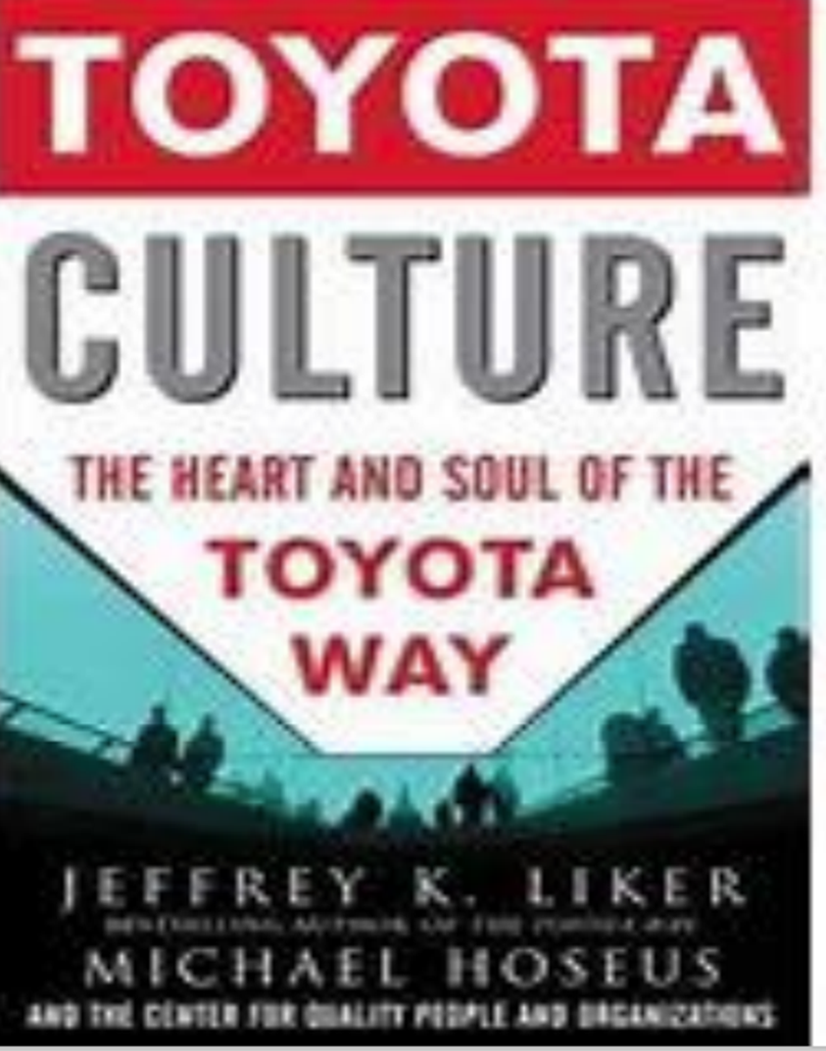
Organizational Culture
Toyota Culture is a book that describes how Toyota developed their organizational culture
Toyota transferred its organizational culture to its plants, dealerships, and offices around the world
The book explains how Toyota’s culture is based on trust, mutual prosperity, excellence, innovation, problem solving, standardization, and long-term thinking
The book also provides a four-stage process for building and keeping quality people

Slide 14
Social Responsibility
Toyota Motor Corporation is deeply committed to sustainability and social responsibility.
Sustainability Fundamental Policy: Toyota adheres to the spirit of the ‘Toyoda Principles’ since its foundation.
The mission is to ‘Produce Happiness for All’ by being a trusted and beloved company. They prioritize customer satisfaction, providing innovative, safe, and high-quality products globally.
For employees, Toyota emphasizes personal growth, equal opportunities, fair working conditions, and respect for human rights.
They actively promote ethical behavior within the organization. In their relationships with business partners, Toyota values mutual trust and long-term collaboration for mutual growth. Social Contribution Activities: Toyota’s founding principle is to contribute to society through automobile manufacturing.

Slide 15
Toyota
Code of
Conduct
Code of Conduct (Ethics)
Toyota ethics are the moral principles of knowing right and wrong that guide the company's actions and decisions.
The company claims to be ethical and to appreciate the public through corporate social responsibilities.
The Toyota Code of Conduct sets guidelines for everyone working at Toyota Motor Corporation and its subsidiaries to follow while at work and engaging with society.
Effective communication can help to solve ethical conflicts and balance the interests of stakeholders.

Slide 16
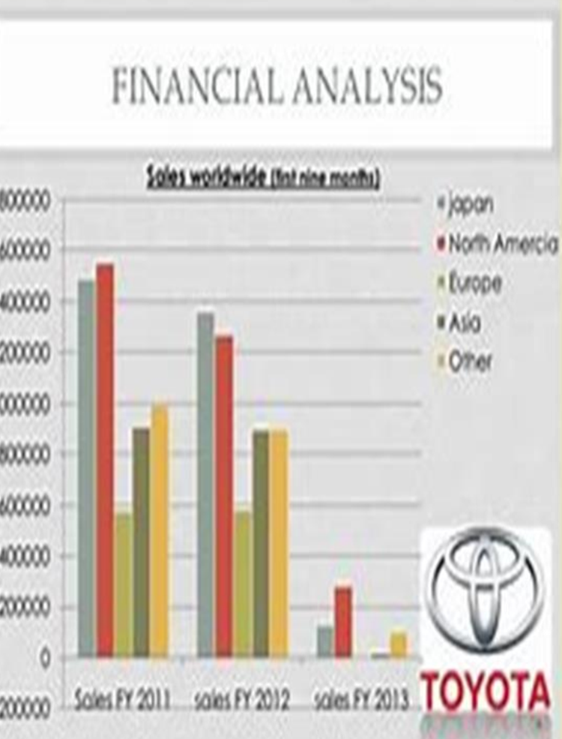
Financial Analysis of Toyota
In the fiscal year of 2023, Toyota sold 8.8 million vehicles, 6.7 million (76%) of which were outside Japan.
North America is Toyota's largest source market. From April 2022 to March 2023, Toyota sold 2.4 million vehicles in North America.
In the same year, Toyota reported revenues of ¥37 trillion, or about $256 billion.
This marked a 15.4% increase from the previous year. Toyota generates most of its revenue from its automotive business, which can be further divided into separate subsegments based on brand and geographic focus.
The company also earns revenue from its financial services branch and through a third, much smaller wing that focuses on various business endeavors

Slide 17
Toyota Recommendations
Strong Focus on Research and Development (R&D):
Toyota’s commitment to R&D has led to innovative vehicles. They could explore emerging technologies like autonomous driving and connected vehicles.
Brand Image and Supply Chain Control:
Toyota’s strong brand image is an asset. They can further enhance it by emphasizing sustainability and social responsibility. By continuously optimizing their global supply chain will help maintain resilience and minimize risks.
Weaknesses to Address:
Hierarchical Organizational Structure: Toyota’s rigid hierarchy limits flexibility. They could explore flatter structures to empower regional operations. Secrecy in Organizational Culture: Reducing secrecy would improve responsiveness to emerging challenges.
Opportunities to Explore:
Self-Driving Vehicles: Toyota can tap into the growing market for autonomous cars. Asian Markets: Expanding in countries like China and India offers untapped potential. Advanced Electronics: Capitalizing on the trend toward electronics in vehicles can boost competitiveness.

Slide 18
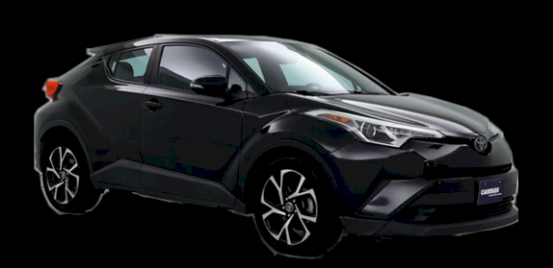
CONCLUSION
Toyota is one of the most successful companies created to research and develop Japan’s own automobile
Toyota Motor Company is the biggest company in Japan and largest manufacturer of forklifts
Toyota also participates in various philanthropic activities, environmental conservation, disaster relief, education, and safety
The net worth of Toyota is approximately $236 billion US and it employs around 340,000 people worldwide
Toyota still run Toyota loom works under Toyota Industries Corporation
Toyota Motor Corporation, founded in 1937 by Kiichiro Toyoda, is a Japanese company that engages in the design, manufacture, assembly, and sale of passenger cars, minivans, commercial vehicles, and related parts of accessories primarily in Japan, North America, Europe, and Asia
The current brands under Toyota include Toyota, Lexus, Daihatsu, and Hino.
It became the largest automobile manufacturer in the world for the first time in 2008, surpassing General Motors
Toyota makes almost 90% of its revenue through the sale of passenger and commercial vehicles

Slide 19
ACKNOWLEDGEMENTS
We would like to give a big thanks to the Dean of The College of Business for giving us this wonderful opportunity to work on this group case study!
A huge thanks to Dr. Yussuf for being a wonderful teacher and letting me & Janeia work together on this assignment!
We enjoyed having you for Strategic Management!
Furthermore, thanks to Dr. Sly for being a wonderful CIS teacher and a great help when needed!
Finally, a huge thanks to Janeia for being a wonderful partner, classmate and the best person ever!
I literally enjoy working with you on assignments because you get the job done!

